Slide 1
HTML

Slide 2
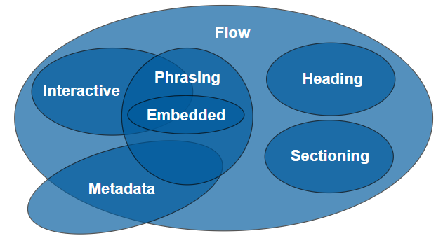

Slide 3
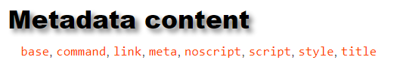

Slide 4
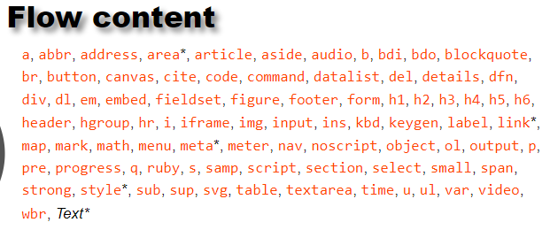

Slide 5


Slide 6


Slide 7
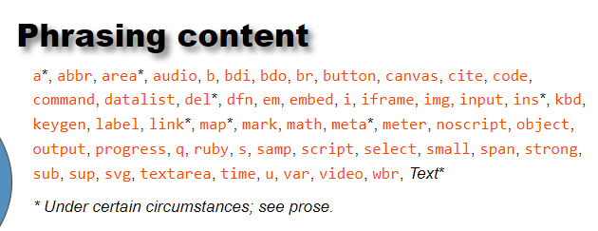

Slide 8
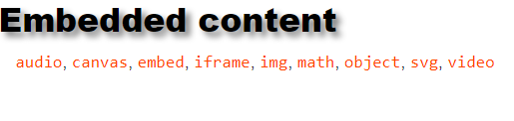

Slide 9
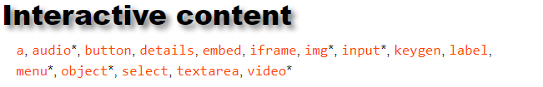

Slide 10
Basic HTML elements
Lists
Tables
Images
Links
Forms
Iframe
Introduce VSCode Editor & Extensions
HTML5 Layout
Canvas
SVG
Audio-Video tags
New Input tags
Web storage

Slide 11
HTML 5 Tags(introduced)

